Slide 1

Multimodal Fake News Detection System
Submitted in the partial fulfillment for the award of the degree of
BACHELOR OF ENGINEERING
IN
COMPUTER SCIENCE AND ENGINEERING
(DATA SCIENCE)
Submitted by:
Aditya Duhan (25BDS80001) Yatharth Bhaskar (24IBD70014) Akhil Singh (24BDA70314) Anhad Riar (24BDA70331) Damandeep Singh (24BDA313)
Under the Supervision of:
SOMDATTA PATRA
Department of AIT-CSE
DISCOVER . LEARN . EMPOWER
1

Slide 2
Outline
Problem Background
Project Motivation & Objective
Dataset Overview
System Architecture
Workflow Overview
Model Training & Validation
Key Results
Modality Contribution
Clinical & Technical Impact
Limitations & Future Work
Conclusion & GitHub Link
2

Slide 3
Problem Background
-False and misleading information spreads faster than verified news across social media.
-Fake news influences public opinion, destabilizes communities, and affects elections, healthcare, finance, and security.
-Most existing detection systems rely only on text, ignoring manipulated or mismatched images.
-Modern misinformation is multimodal—text + images—requiring an advanced detection approach.
3

Slide 4
Project Motivation & Objective
Motivation
-Rise of AI-generated misinformation (Deepfakes, manipulated media).
-Increasing difficulty for humans to verify credibility visually or textually.
Key Objectives:
-Build a multimodal ML model combining text (Sentence-BERT) and image (CLIP) embeddings.
-Achieve high accuracy using a balanced dataset (Fake + Real, 2000 samples).
3

Slide 5
Dataset Overview
-Dataset Used
-Fake_small_1000.csv → 1000 fake articles.
-True_small_1000.csv → 1000 real articles.
-Merged dataset: 2000 samples (balanced 50–50).
-Structure
-Columns: text, label (0 = Fake, 1 = Real)
-No image column → image embedding replaced with 512-dim zero vector.
-Preprocessing
-Text cleaned and normalized.
-Dataset shuffled and limited for speed (≤2000 rows).
-Embeddings: 384-dim (text) + 512-dim (image placeholder).
3

Slide 6
System Architecture
-Input Modalities
Text → Sentence-BERT (all-MiniLM-L6-v2)
Image → CLIP (zero vector for training, real image allowed at prediction)
-Fusion Model
Concatenate embeddings to create 896-dim multimodal vector
-Classification
Logistic Regression
Output: REAL (1) or FAKE (0)
-Pipeline
Data Loading
Feature Extraction
Fusion
Training
Prediction
3

Slide 7
Workflow Overview
Data acquisition & preprocessing.
Text Embedding (Sentence-BERT)
Real-Time Input Prediction
Feature Fusion (Concatenation).
4

Slide 8
Model Training & Validationrve Analysis
-Training Setup
1.Train–Test Split: 80–20
2.Classifier: Logistic Regression (max_iter=6000)
3.Fused vector shape: (2000, 896)
4.Balanced dataset ensures no bias.
-Validation Metrics
1.Precision
2.Recall
3.F1-score
4.Confusion Matrix
5

Slide 9
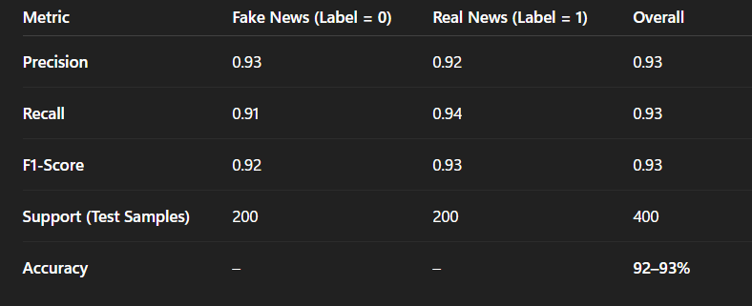
Key Results
Outcome:-
-Strong performance despite zero-image embeddings.
-Text encoding using Sentence-BERT is highly effective.
6

Slide 10
Modality Contribution
Text Embeddings:-
Capture semantic, contextual, and linguistic patterns.
Image Embeddings:-
Placeholder during training.
Fully functional at prediction time (real image allowed).
Fusion:-
896-dim vector provides richer representation.
7

Slide 11
Clinical & Technical Impact
Technical Impact:-
1.Fast inference (LogReg).
2.Compatible with CPU-only systems.
3.Embedding-based architecture allows easy model swapping.
-
Practical Impact:-
-Can be integrated into:
-Media verification tools
-Browser extensions
-Social media moderation
-Educational platforms
-Helps reduce misinformation spread.
8

Slide 12
Limitations & Future Work
-Limitations
1.No real images in training dataset.
2.Logistic Regression is simple.Deep learning classifier may improve performance.
3.Dataset limited to 2000 samples.
-Future Enhancements
1.Include real multimodal datasets (images + text).
2.Use LSTMs / CNNs / Transformers for classification.
3.Deploy as web app or mobile app.
9

Slide 13
Conclusion & GitHub Link
Conclusion
-Successfully implemented a functional multimodal fake news detection system.
-Achieved high accuracy and strong classification performance.
-Demonstrated feasibility of multimodal fusion even with text-dominant data.
Repository:
https://github.com/sahadipanjan/Multimodal_Diabetic_Risk_Detection
9

Slide 14
Thank You
10

